Slide 1

Application Modernization in the Software Industry
Unlock Agility, Cost Savings, and Scalability with Modern Architectures and Strategies

Slide 2



Three-Phase Modernization Pipeline
Assess
Modernize
Manage
Inventory legacy apps, map dependencies, identify bottlenecks.
Choose & apply “7 R” strategies (Replace, Rehost, etc.).
Monitor performance, security, costs & continuously optimize.
This structured pipeline ensures a systematic approach to transforming your application landscape, minimizing risks and maximizing value.

Slide 3


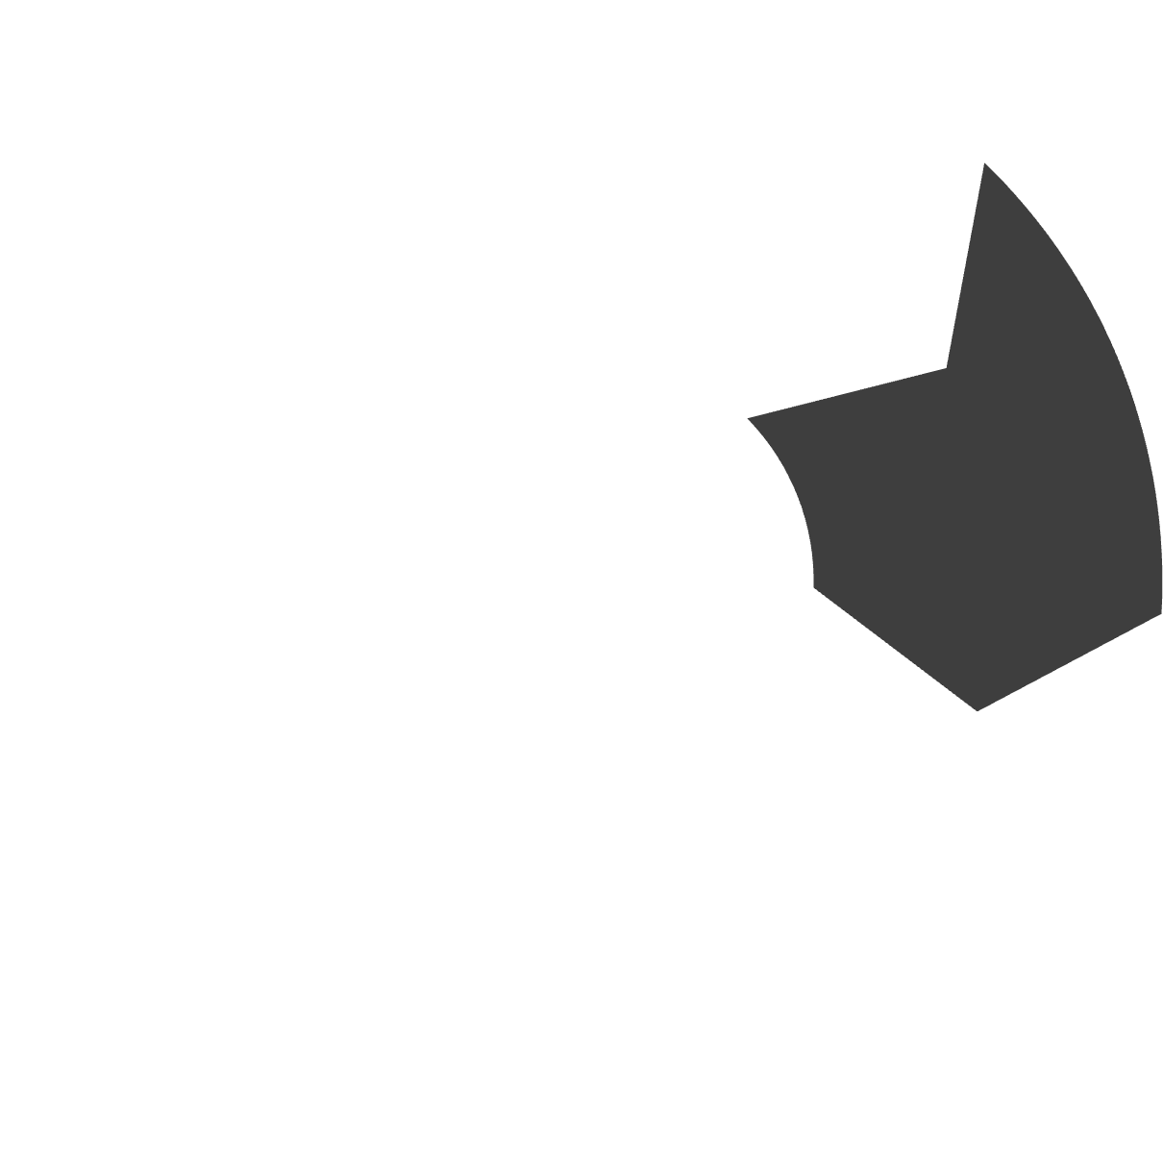



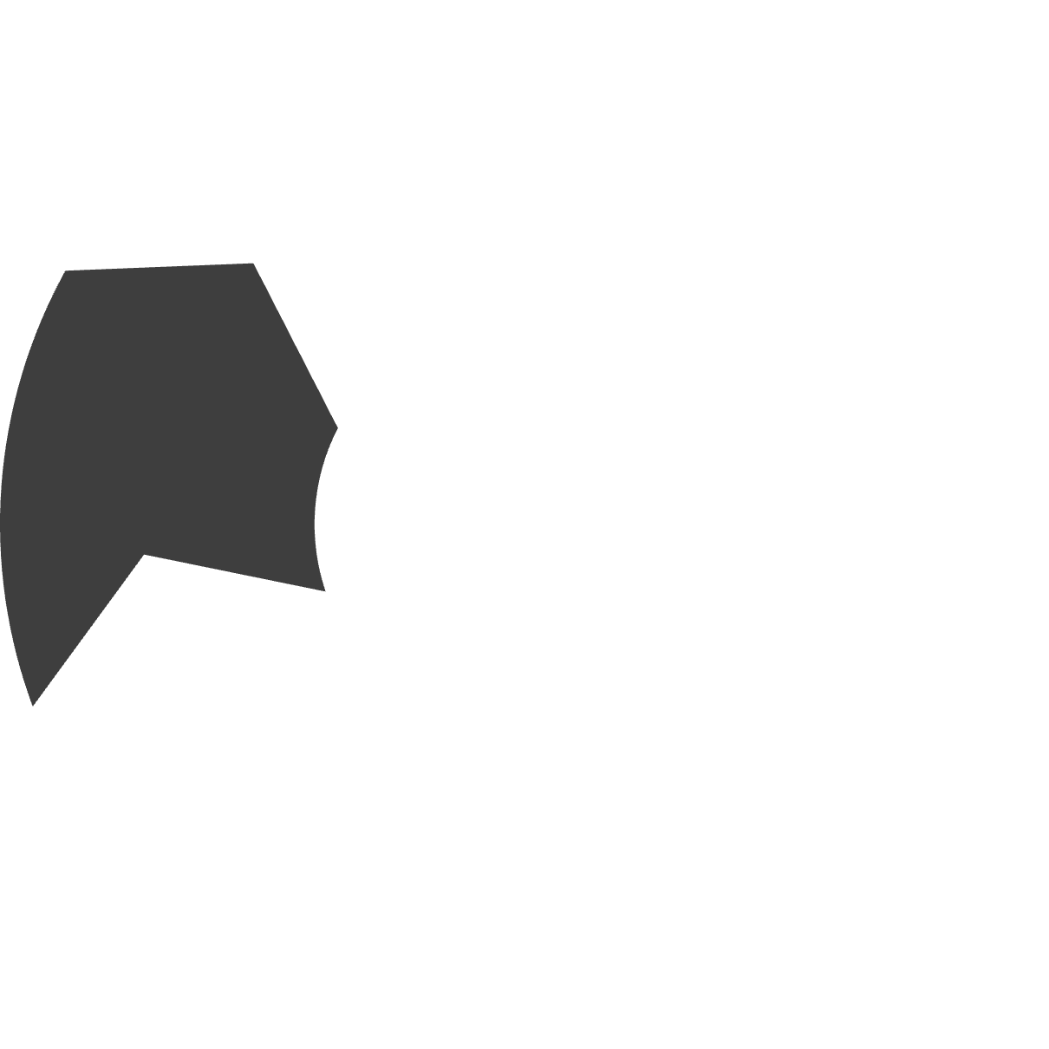







The “7 R” Strategies for Application Modernization
Replace
Rehost
Retire and replace with a new SaaS solution.
Lift-and-shift applications to the cloud.
Replatform
Move to the cloud with minor optimizations.
Retire
Decommission applications no longer needed.
Refactor
Rearchitect code to leverage cloud features.
Rebuild
Rearchitect
Completely re-write the application from scratch.
Modify code to adapt to a new architecture.
Choosing the right strategy is crucial for a cost-effective and impactful modernization journey.

Slide 4




Cloud-Native Technologies Powering Modern Apps
Enables scalability, agility, and reduced operational overhead.
Microservices
Containers
Decompose applications into small, independent services.
Package applications with all dependencies for consistent deployment.
Serverless
API-First
Run code without provisioning or managing servers.
Design applications around accessible and well-documented APIs.

Slide 5
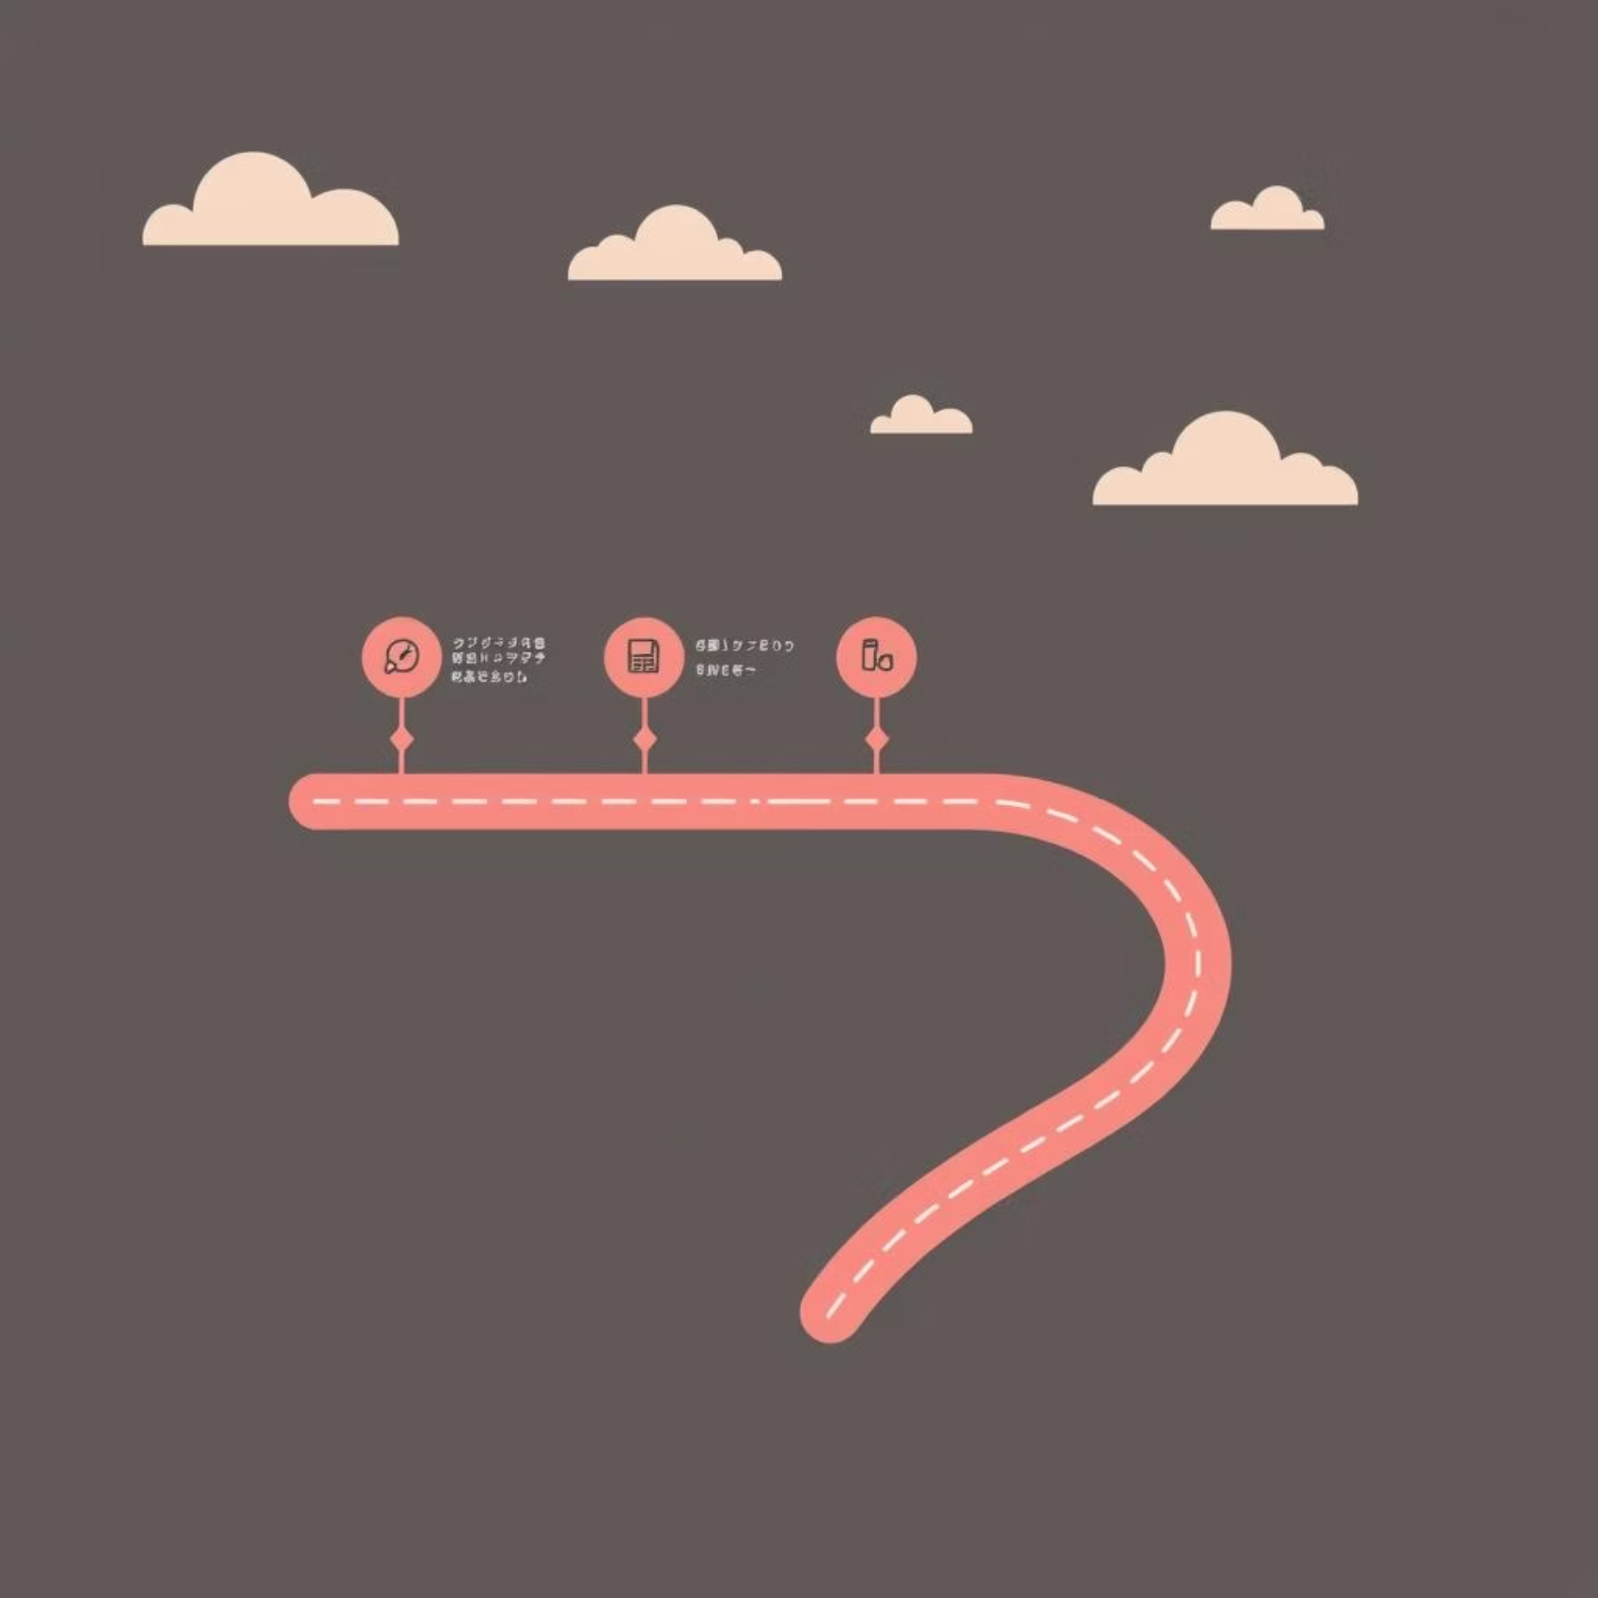
Best Practices to Ensure Success
Comprehensive legacy assessment & prioritization to understand current state.
Align roadmap with business KPIs & goals for measurable impact.
Incremental delivery with DevOps & CI/CD pipelines for continuous improvement.
Strong governance, security, and compliance to mitigate risks.
Adhering to these practices will pave the way for a smooth and effective modernization journey.

Slide 6
Key Metrics Before & After Modernization
Metric
Before Modernization
After Modernization
Deployment Frequency
Monthly/Quarterly
Daily/Hourly
Mean Time to Recovery
Hours/Days
Minutes/Seconds
Infrastructure Cost
High
Reduced (cloud autoscaling)
Application Uptime
99%
99.9%+
Feature Lead Time
Months
Weeks/Days
These metrics demonstrate the tangible improvements and business value gained from modernization efforts.

Slide 7
Unlock the Full Potential of Your Applications
Thorough Assessment
1
Understand your current landscape.
Strategic R Selection
2
Choose the right modernization path.
Cloud-Native Adoption
3
Embrace modern architectures.
Continuous Optimization
4
Measure and refine for impact.
Modernization is a journey of continuous improvement, not a one-time event.

Slide 8
Overcoming Modernization Challenges
Proactive strategies to navigate common hurdles:
Legacy Data Migration
Skill Gap
Develop robust data migration strategies and tools to ensure integrity and minimize downtime.
Invest in upskilling existing teams and strategic hiring for new cloud-native expertise.
Cost Management
Organizational Resistance
Implement FinOps practices and detailed cost monitoring to optimize cloud spend.
Foster a culture of change and provide clear communication on the benefits of modernization.

Slide 9
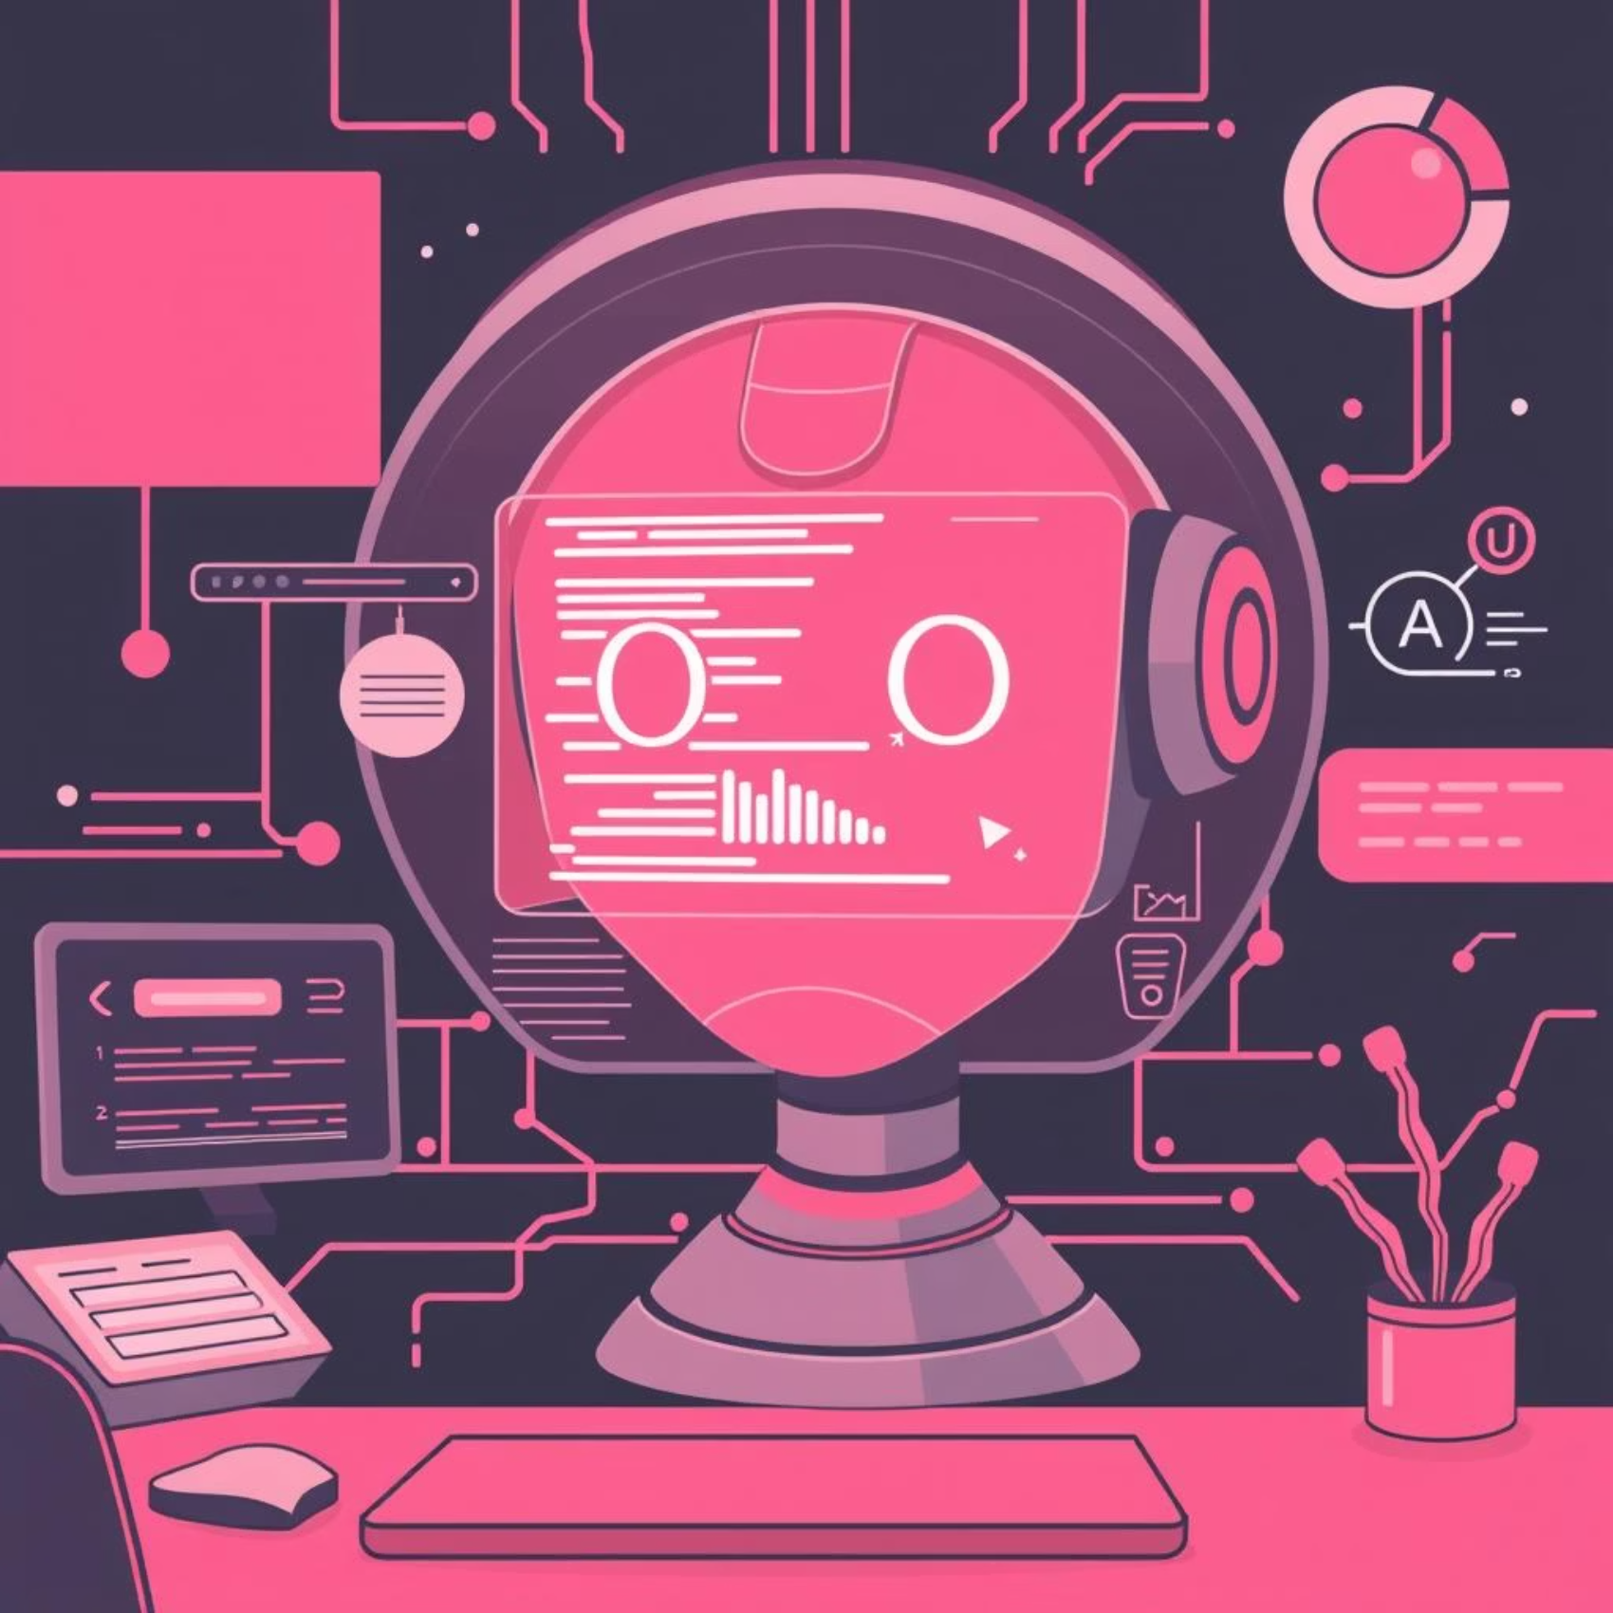
The Future of Application Modernization: AI-Driven
Artificial Intelligence is rapidly transforming application modernization, offering unprecedented opportunities for efficiency and innovation.
Automated Code Refactoring: AI-powered tools can analyze legacy code and suggest refactoring improvements, accelerating the modernization process.
Predictive Maintenance: AI monitors application performance and predicts potential issues before they impact users, reducing downtime.
Intelligent Resource Optimization: Machine learning algorithms dynamically adjust cloud resources, leading to significant cost savings.
Enhanced Security: AI-driven security systems identify and mitigate threats in real-time within modernized applications.
Embracing AI will be key to staying competitive in the evolving software landscape.

Slide 10
Your Next Steps Towards Modernization
1
2
3
Schedule a Discovery Call
Receive a Tailored Assessment Proposal
Begin Your Modernization Journey
Let's discuss your specific modernization needs and challenges.
We'll outline a comprehensive plan for your legacy applications.
Partner with us to transform your applications for the future.
Ready to unlock agility, cost savings, and scalability?

